Slide 1

SQL PROJECT
LOAN MANAGEMENT SYSTEM
ANALYSIS
-Balasaravanan kannan

Slide 2

DATA SET
Customer Income Status
Loan Status
Customer Info
Country State
Region Info

Slide 3
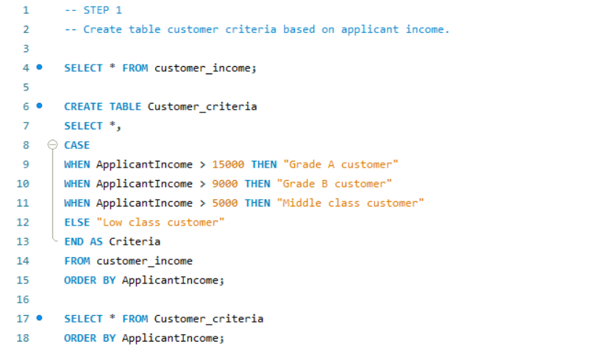
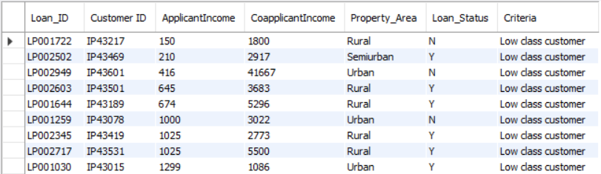
STEP 1
Import table from sheet 1- customer income status.
Set customer criteria based on applicant income.
INPUT
OUTPUT

Slide 4
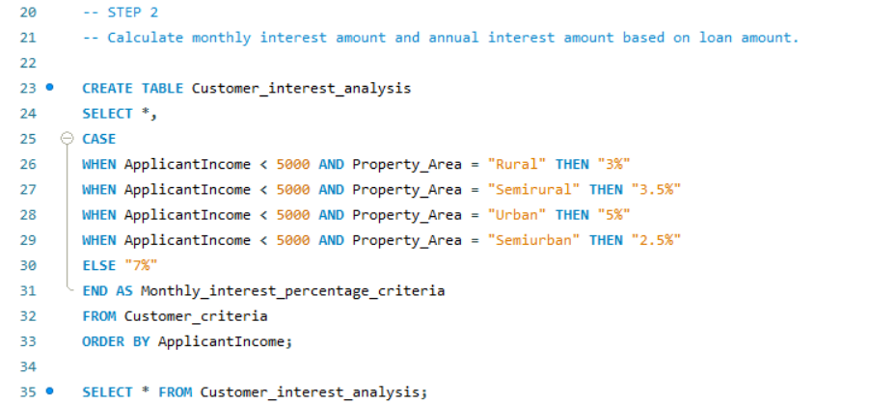
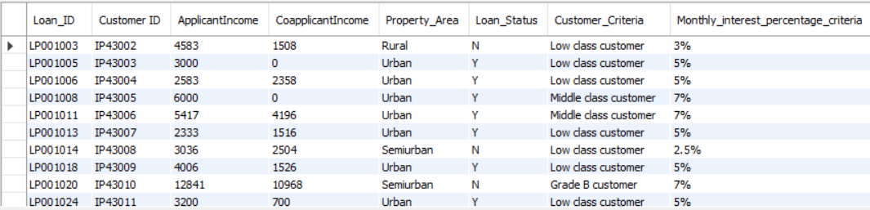
STEP 2
Calculate monthly interest percentage criteria based on Applicant income.
Calculate monthly interest amount and annual interest amount based on loan amount.
INPUT
OUTPUT

Slide 5
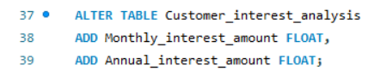
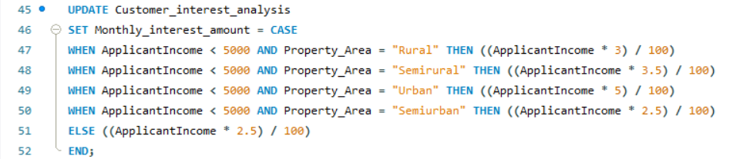
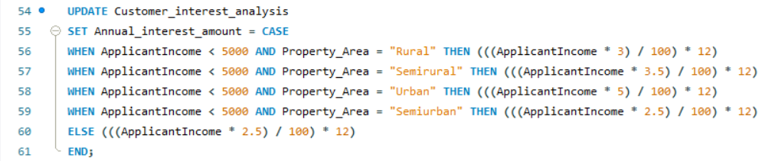
INPUT

Slide 6
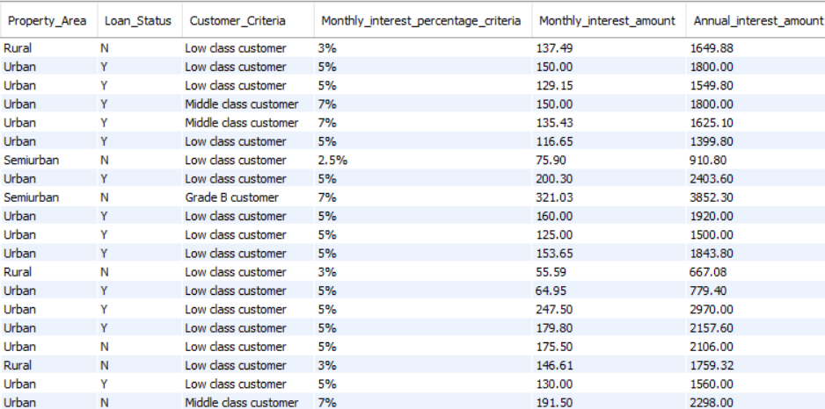
OUTPUT

Slide 7
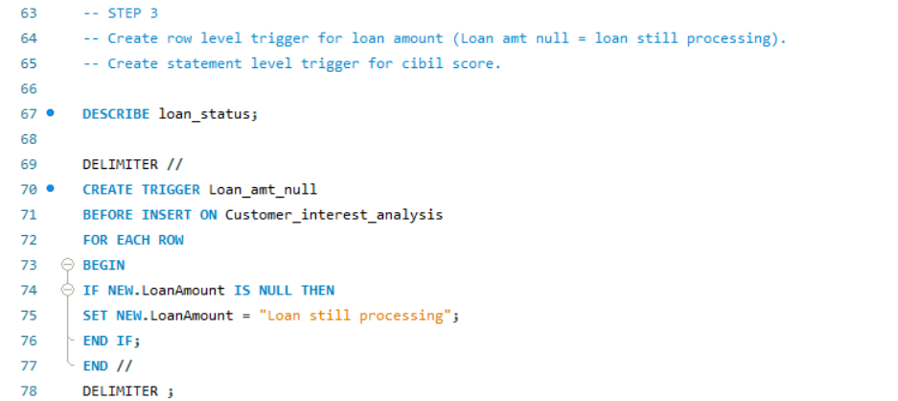
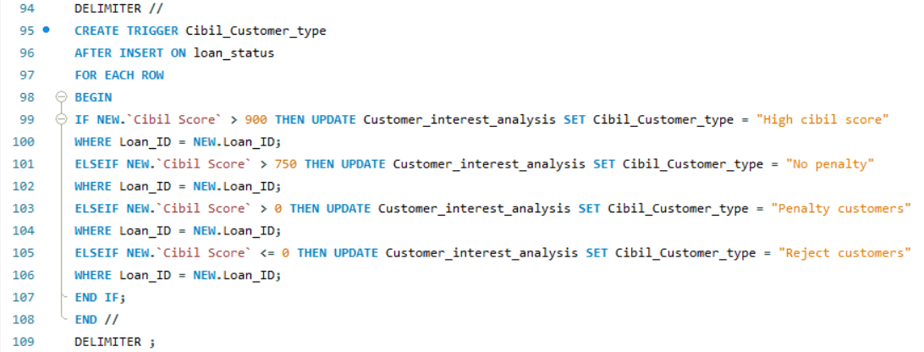
STEP 3
Create row level trigger for loan amount (Loan amt null = loan still processing).
Create statement level trigger for cibil score.
INPUT

Slide 8
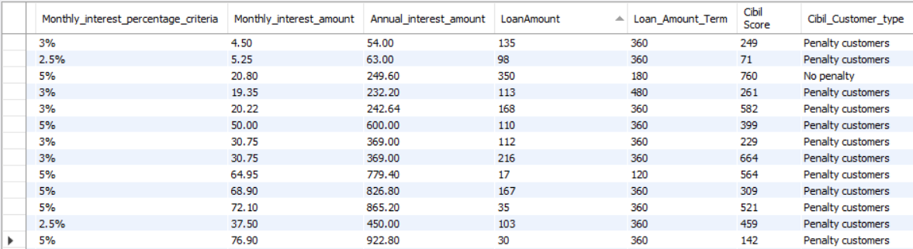
OUTPUT

Slide 9
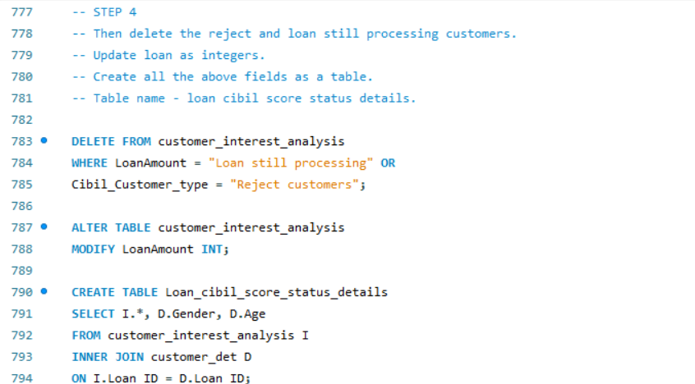
STEP 4
Then delete the reject and loan still processing customers.
Update loan as integers.
Create all the above fields as a table.
Table name - loan cibil score status details.
INPUT

Slide 10
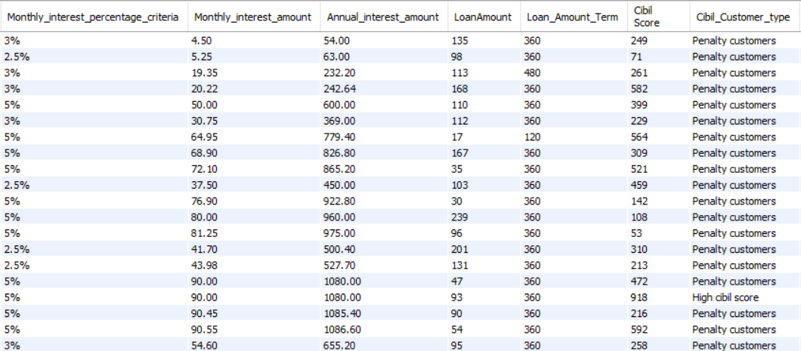
OUTPUT

Slide 11
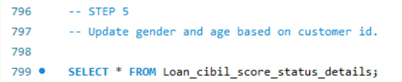
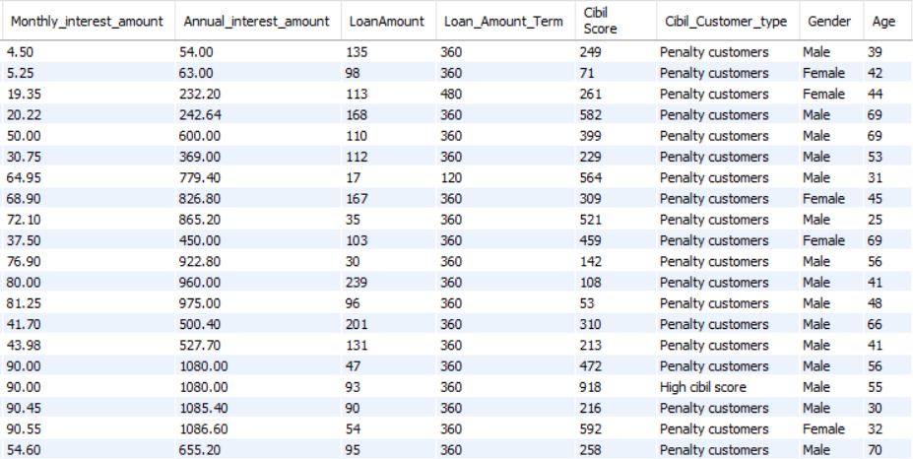
STEP 5
Update gender and age based on customer id.
INPUT
OUTPUT

Slide 12
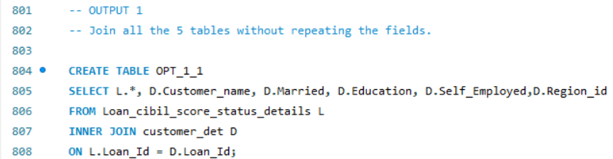
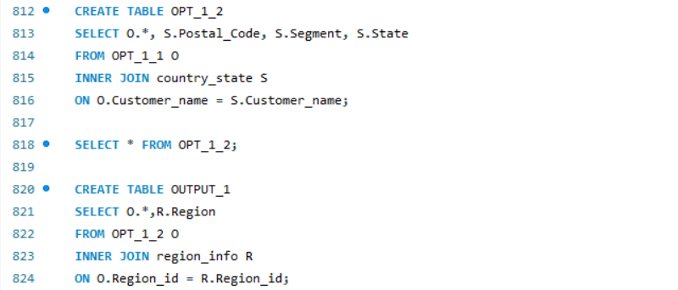
FINAL RESULT
OUTPUT 1
Join all the 5 tables without repeating the fields.
INPUT

Slide 13
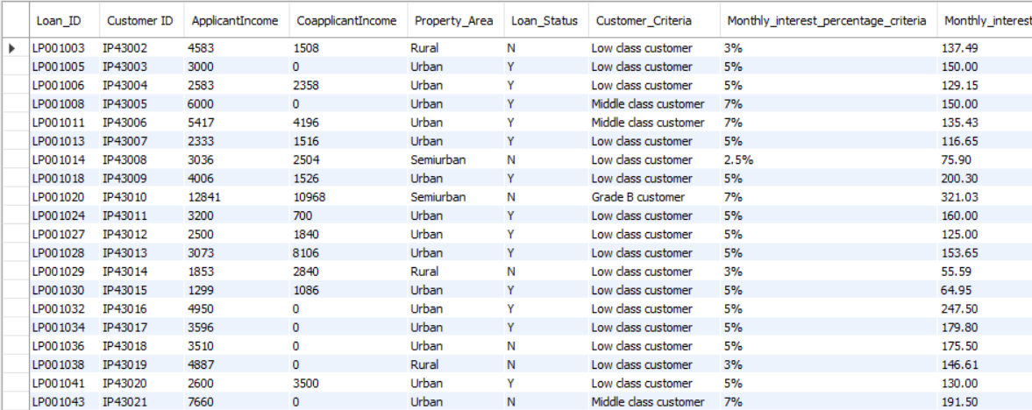
OUTPUT

Slide 14
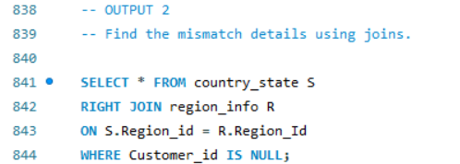
OUTPUT 2
Find the mismatch details using joins.
INPUT
OUTPUT

Slide 15
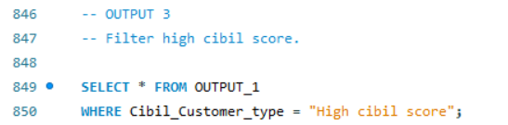
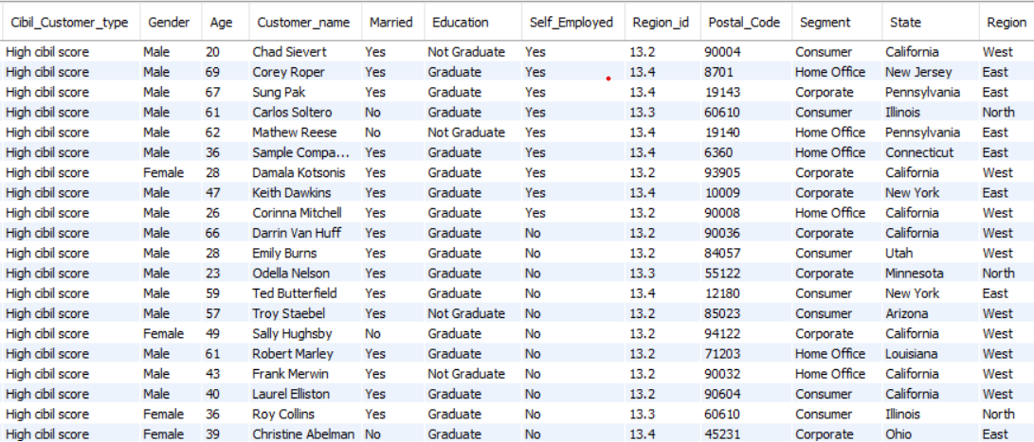
OUTPUT 3
Filter high cibil score.
INPUT
OUTPUT

Slide 16
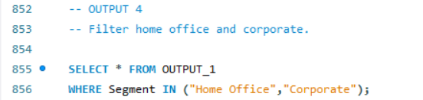
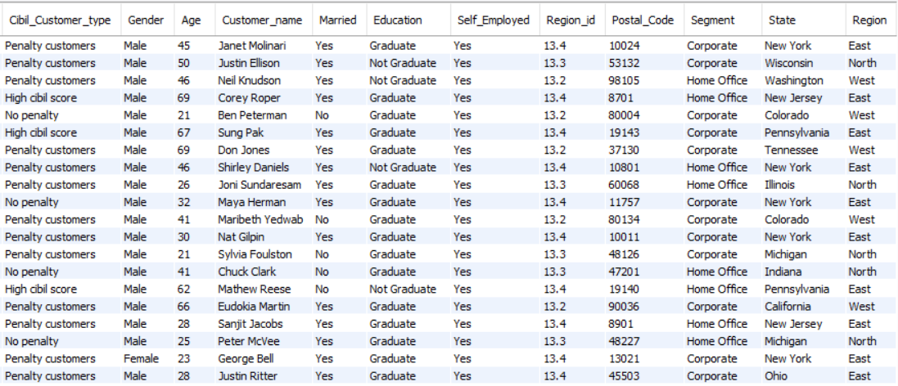
OUTPUT 4
Filter home office and corporate.
INPUT
OUTPUT

Slide 17
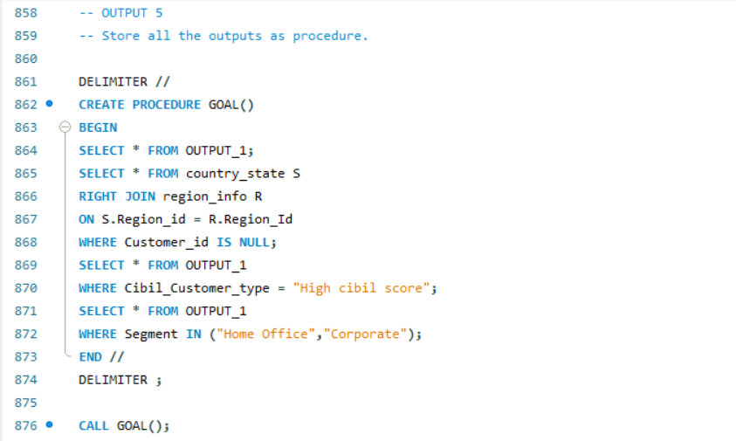
OUTPUT 5
Store all the outputs as procedure.
INPUT

Slide 18
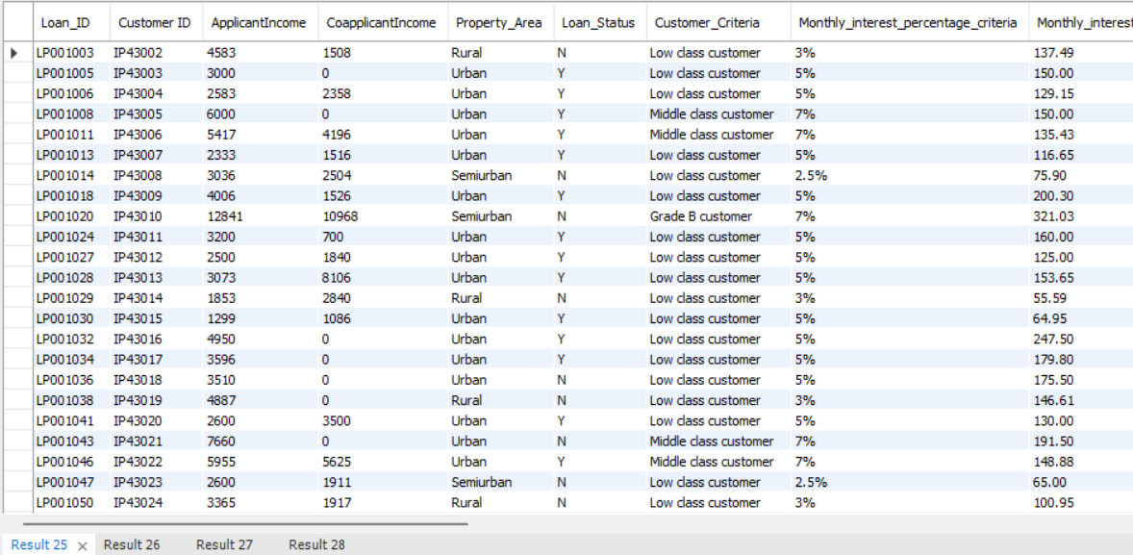
OUTPUT
RESULT 1
RESULT 2
RESULT 3
RESULT 4

